Slide 1
Sequence relatedness via networks in the sequence space and its application

Slide 2
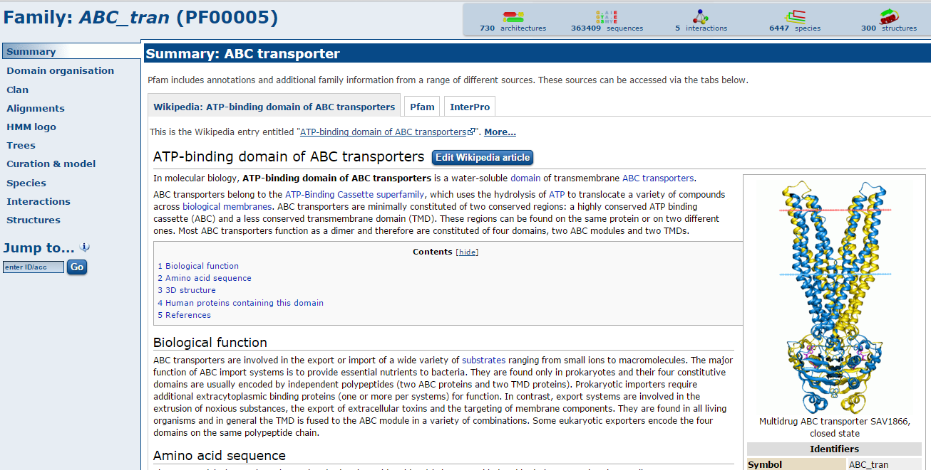
The problem
Each protein sequence requires detailed annotation
The most common approach – homology modeling
Notes:
Add slide – what is annotatiln
Add protein name/function/source

Slide 3
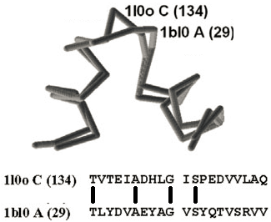
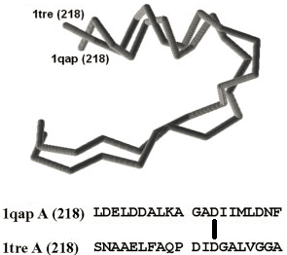
The problem
The structure/functions of two proteins (protein fragments) can be very similar but the corresponding sequences can be without any detectible similarity.
1bl0 transcription factor from E.coli
1l0o sigma factor from Bacillus
1tre Triosephosphate isomerase from E.coli
1qap pyrophosphorylase from Salmonella
This problem often makes impossible effective protein sequence analysis and annotation (i.e. prediction of structural/functional properties of correspondent proteins).
Notes:
Add slide – what is annotatiln
Add protein name/function/source

Slide 4
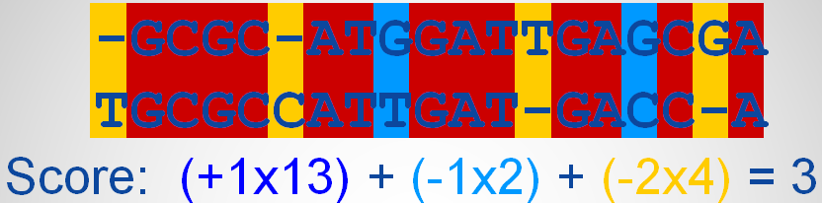
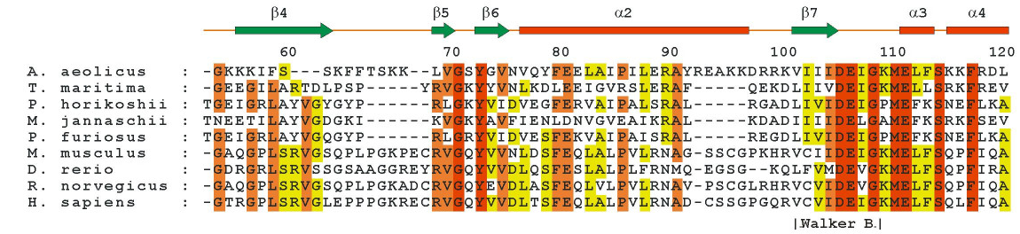
The Existing Solutions
Pair sequence alignment
Enhanced by multiple sequence alignment
But! There is a lots of meaningless noise or provides only trivial solutions
Notes:
Blast its derivatives and heuristic
The weaknesses:
Trivial solutions
Lots of meaningless noise
Pair sequence alignment
Enhanced by multiple sequence alignment
But! There is a lots of meaningless noise or provides only trivial solutions

Slide 5
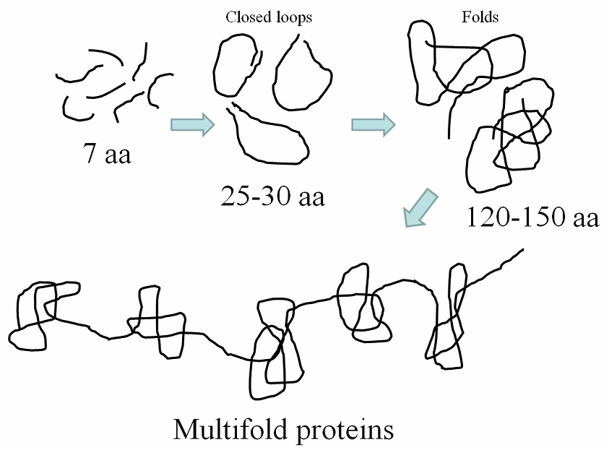
Modern view on protein evolution
Each evolutionary stage is accompanied by multiple mutational changes, making relatedness of descendants of a common ancestor undetectable.

Slide 6
Nice illustration
ANCIENT
mutational process
mutational process
ANCIENT
CNCIENT
CNCRENT
CUCRENT
CURRENT
ANCIENT
ARCIENT
ARCSENT
PRCSENT
PRESENT
ANCIENT
ANCIANT
INCIANT
INCTANT
INSTANT
But actually:
CURRENT = PRESENT = INSTANT

Slide 7
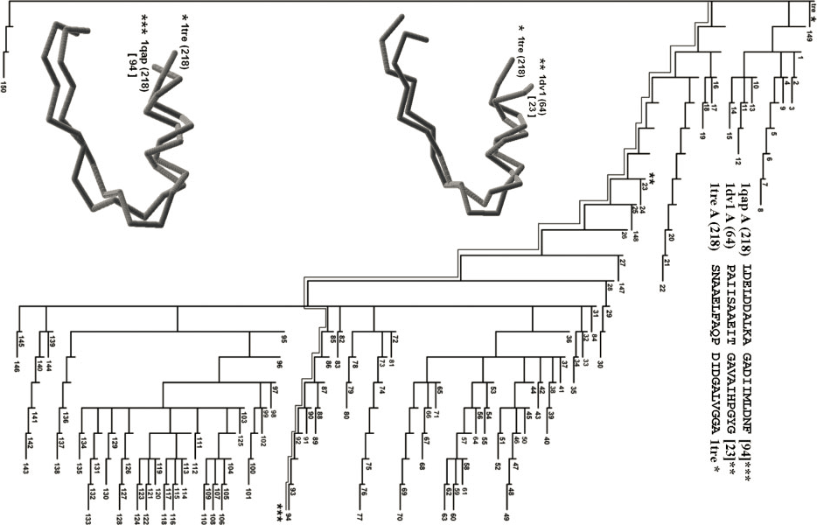
Similarly, we can find for proteins in nature

Slide 8
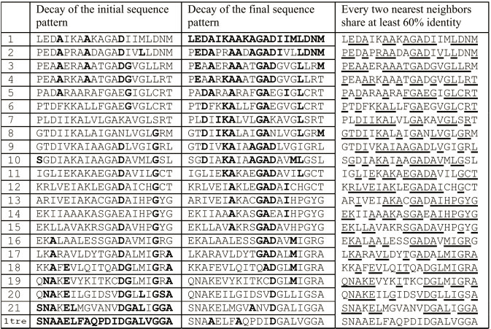
Similarly, we can find for proteins in nature

Slide 9
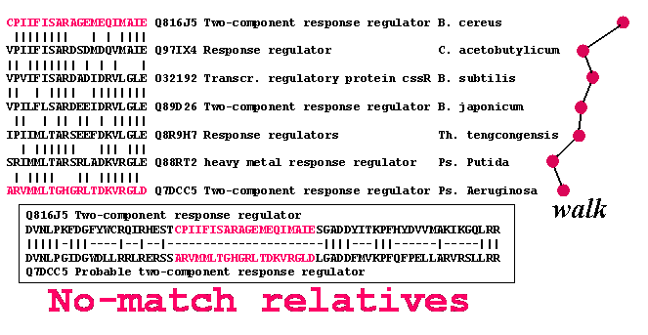
The evolutionary effect
Gradual sequence changes
Selection only ‘functional’ sequences (extinction of ‘non- functional’ )
No. of sequenced proteins growing exponentially (over 50 million, 2014)
Lager databases ➔ Bigger Problem ➔ Stronger Solution

Slide 10
The evolutionary “walk”
Note – two related sequences without any matching amino acids

Slide 11
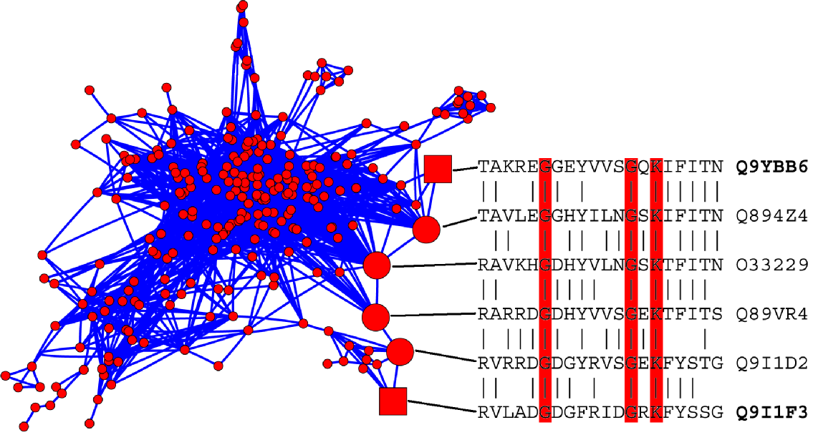
Main concept – “network”
Commonly, the sequence walks make branches, forming "evolutionary networks” or “protein connectivity networks” (PCN).
Each node is a sequence of size about 20 amino acids.
This size is very
important for predictive abilities of the method.
The edges reflect high similarity between the sequences of corresponding nodes.

Slide 12
To be related the sequences do not have to be similar (upto even complete mismatch)

Slide 13
One can make long
walks
from fragment to fragment in the
formatted protein sequence space
(sequence fragments of the same length, 20 residues,
gathered from all or many proteomes)
Pair-wise connected matching fragments make also
networks

Slide 14
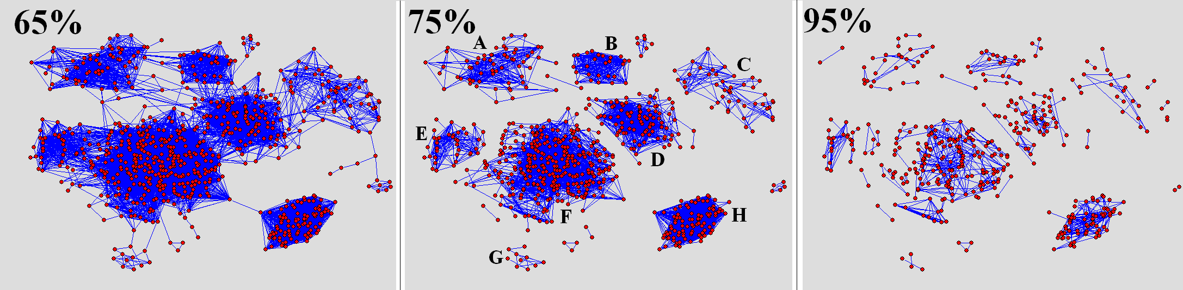
Networks of fragments of aa-tRNA synthetases
at various thresholds of sequence match
A tyr trp B met C arg trp D cys
E leu F met leu ile val G ile H lepA

Slide 15
New definition of sequence relatedness:
fragments of the same network
are relatives

Slide 16
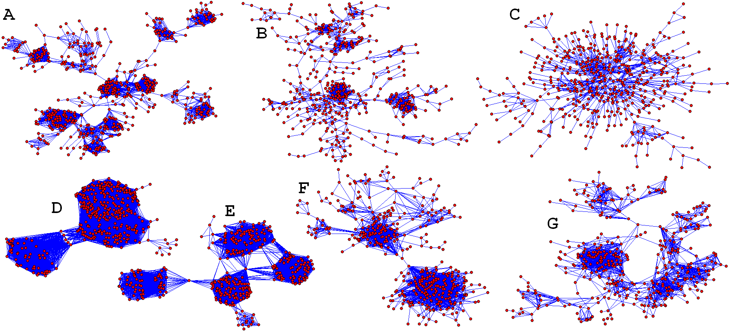

Slide 17
Application 1:
Protein structure prediction

Slide 18
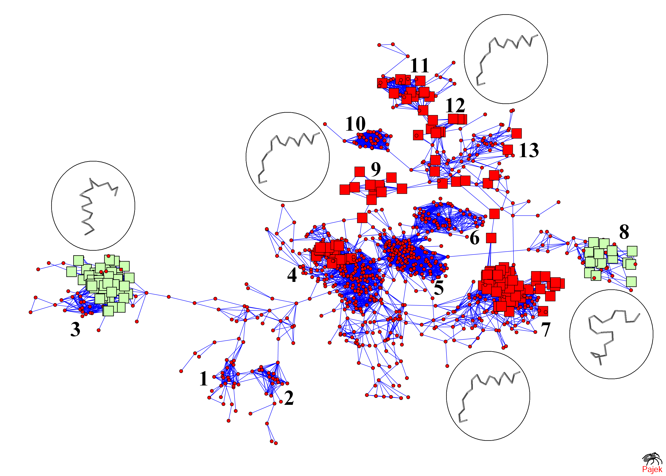
1 Putative peptidoglycan bound protein
2 Collagen adhesion protein
3 Ribosomal protein L11
4 Penicillin-binding protein 2x
5 Penicillin-binding protein 1
6 Penicillin binding protein 2A
7 D-alanyl-D-alanine carboxypeptidase
8 cytochrome
9 Beta-Lactamase
10 Mannitol-1-phosphate 5-dehydrogenase
11 glutaminase
12 Beta-lactamase
13 Esterase EstB
Fragments of the same network
have, essentially, the same structure.
Periferal fragments may be different

Slide 19
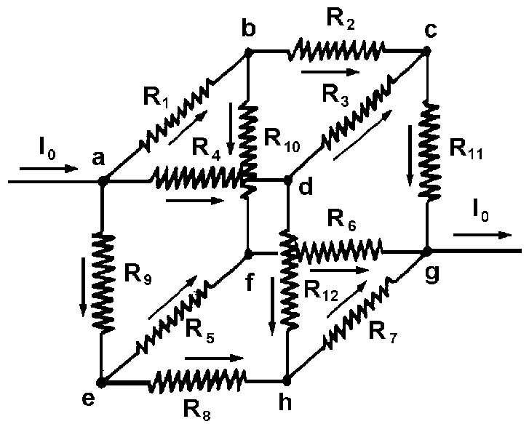
Main approach:
Electrical network model
The current in this model is the ability of protein fragment to transmit biological properties from one fragment to another
The parameter, reflecting relatedness of fragments, will be "conductivity" (inverse resistance) between corresponding nodes

Slide 20
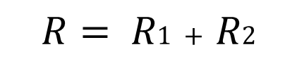
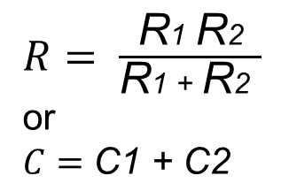
Why Electrical Model ?
Ohm's law:
R1
R2
[Distance]
$$R= R1 + R2$$
R1
$R= \frac{ \text{R}\text{1} \text{R}\text{2} }{\text{R}\text{1 }\text{+ }\text{R}\text{2} }$ or
$C=$ $\text{C}\text{1 }\text{+ }\text{C}\text{2}$
[Alternative Paths]
R2
As the distance between the nodes is longer, the resistance is bigger
As we have more alternative paths, the resistance is less
Notes:
ככל שיותר דרכים אלטרנטיביות וככל שהדרך קצרה , התנגדות תהיה קטנה = (מוליכות הפוכה להתנגדות) ומוליכות תהיה גבוהה ואחוז הדימיון במבנים גבוה.

Slide 21
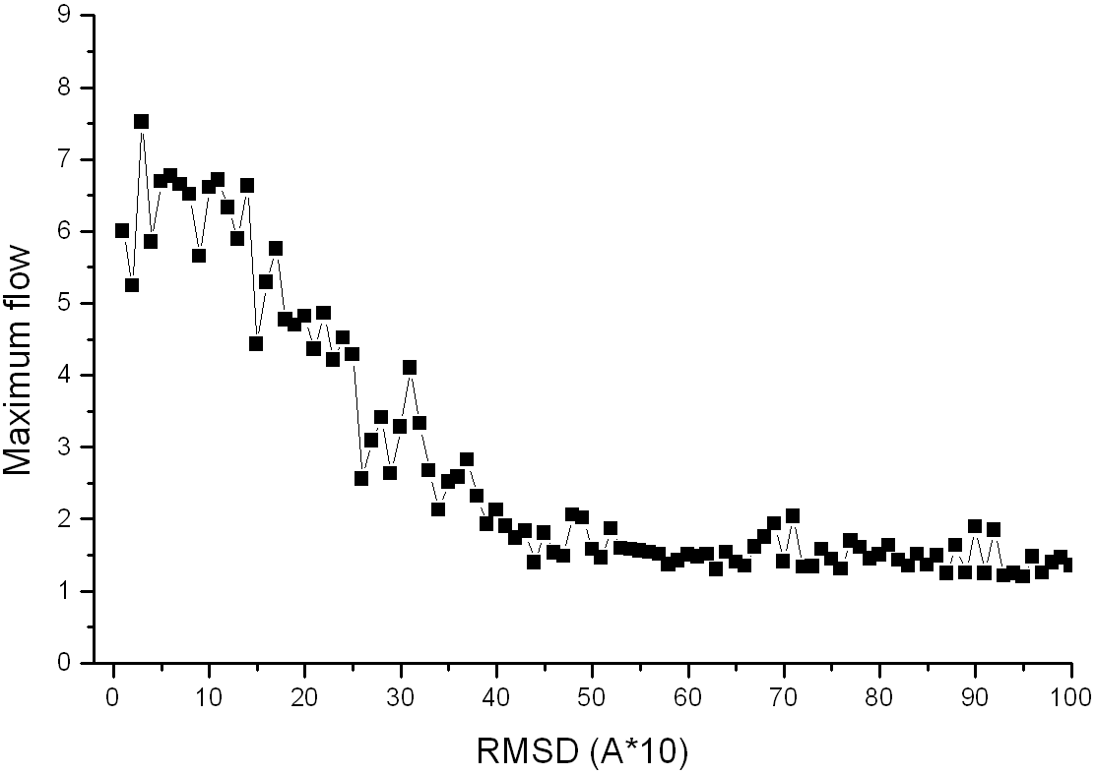
Dependence of maximum flow on RMSD.

Slide 22
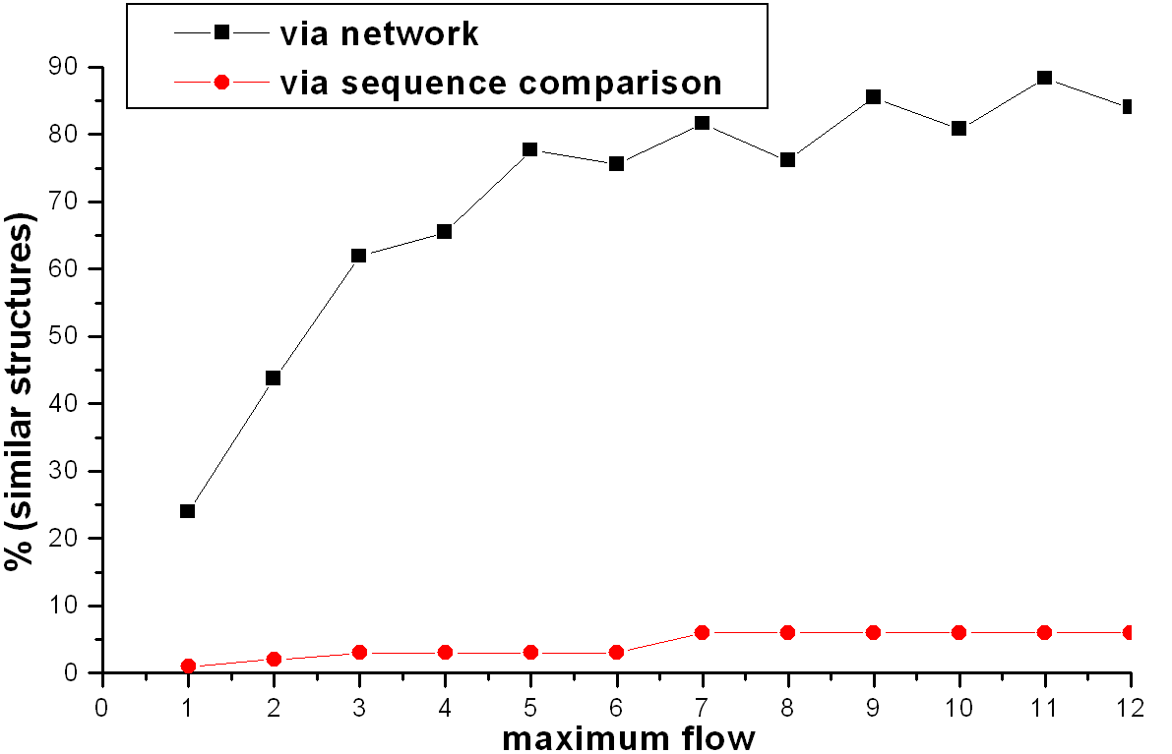
Dependence of the part of similar structures (RMSD < 3A) on maximum flow.

Slide 23

Introduction of weighted resistance of the edges
But how to do it
A possible answer:
The function may be written in a polynomial representation (i.e. Taylor series):
R = a₁₀*X + a₁₁*Y + a₂₀*X² + a₂₁*X*Y +
a₂₂*Y² +…+ a_{k0}*X^{k} + a_{k1}X^{k-1}*Y + … +
a_{kk-1}*X*Y^{k-1} + a_{kk}* Y^{k} = RMSD,
R denotes resistance,
X denotes amount (proportion) of mismatches in 20 amino acid fragments correspondent to nodes,
Y denotes amount of mismatches (proportion) in correspondent adjacent sequences,
a_{ij} denote polynomial (Taylor) coefficients (that we should find).

Slide 24
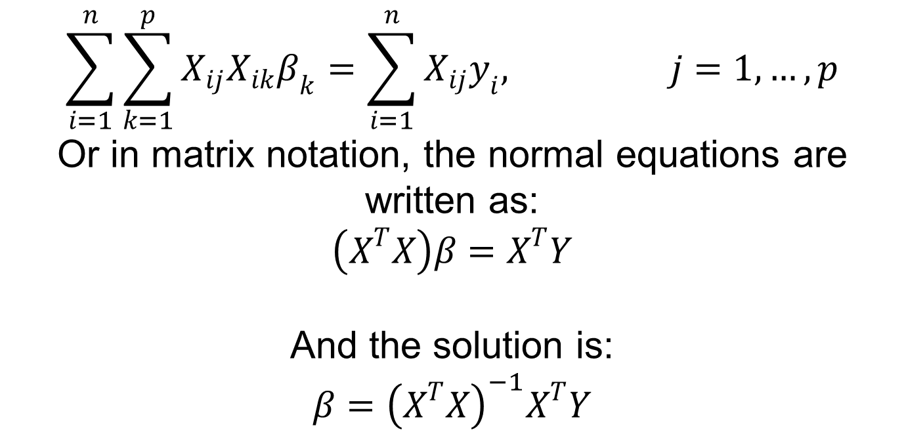
Introduction of weighted resistance of the edges
The polynomial (Taylor) coefficients can be extracted from training data by using linear regression model with least-squares estimation:
$$\sum_{i=1}^{n}{\sum_{k=1}^{p}{X_{ij}X_{ik}β_{k}=\sum_{i=1}^{n}{X_{ij}y_{i}, j=1,…,p}}}$$
Or in matrix notation, the normal equations are written as:
$$\left(X^{T}X\right)β=X^{T}Y$$
And the solution is:
$$β={\left(X^{T}X\right)}^{−1}X^{T}Y$$

Slide 25
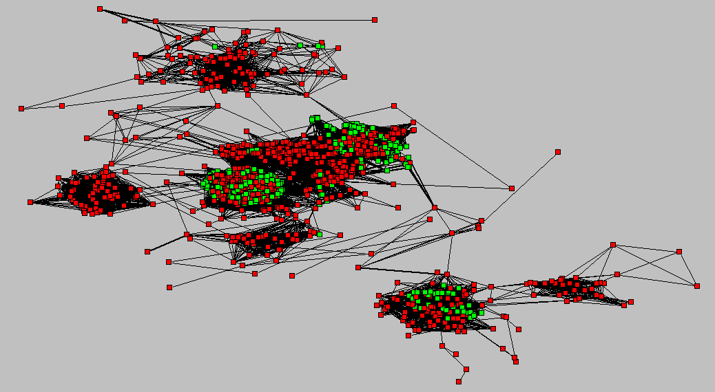
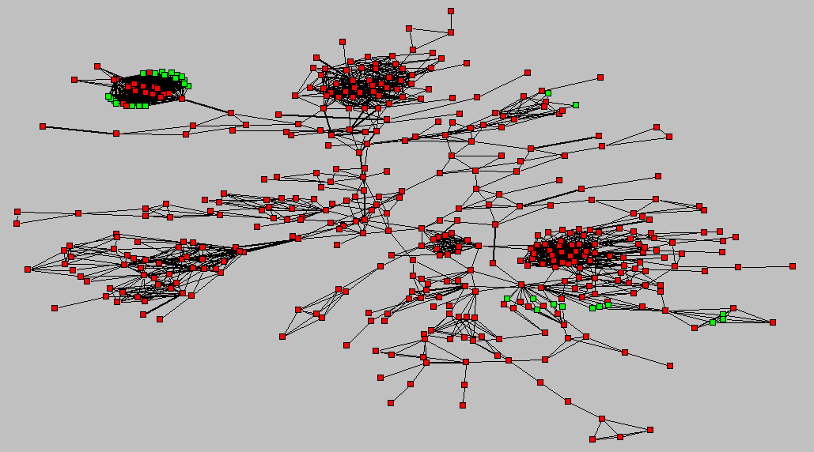
Introduction of weighted resistance of the edges
The are two types of the training data:
The first made on the basis of Astral database:
$NODE1 NODE2 SEQUENCES X Y_R_L RMSD
>20 6 24 $ERVASHPLLKPIFPSDLTET$ $RRVAAHPDLRPIFPDDLTET$ 15 9 4 0.278518
>21 6 25 $RVASHPLLKPIFPSDLTETA$ $RVAAHPDLRPIFPDDLTETA$ 16 9 4 0.276372
>22 6 26 $VASHPLLKPIFPSDLTETAR$ $VAAHPDLRPIFPDDLTETAH$ 15 10 5 0.278619
...
2. The second is a set of networks containing some nodes with known structure

Slide 26
Application 2: Detection of the protein module structure
Every fragment is tagged (protein, species)
It is also uniquely located in it´s family network.
The size of the network says
how many relatives the fragment has
Thus, one can take a sequence
and for all fragments of it
find their networks and plot the sizes

Slide 27
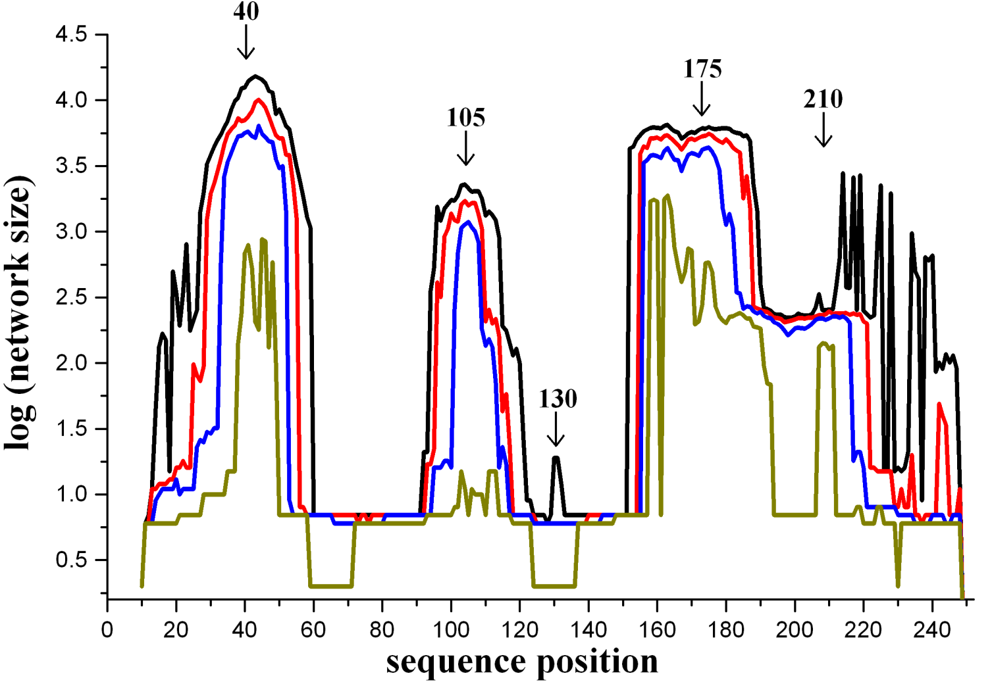
This generates the maps of modules
from which the protein is built
for example:
Modules of histidine permease, ATP binding subunit
(ABC transporter)

Slide 28
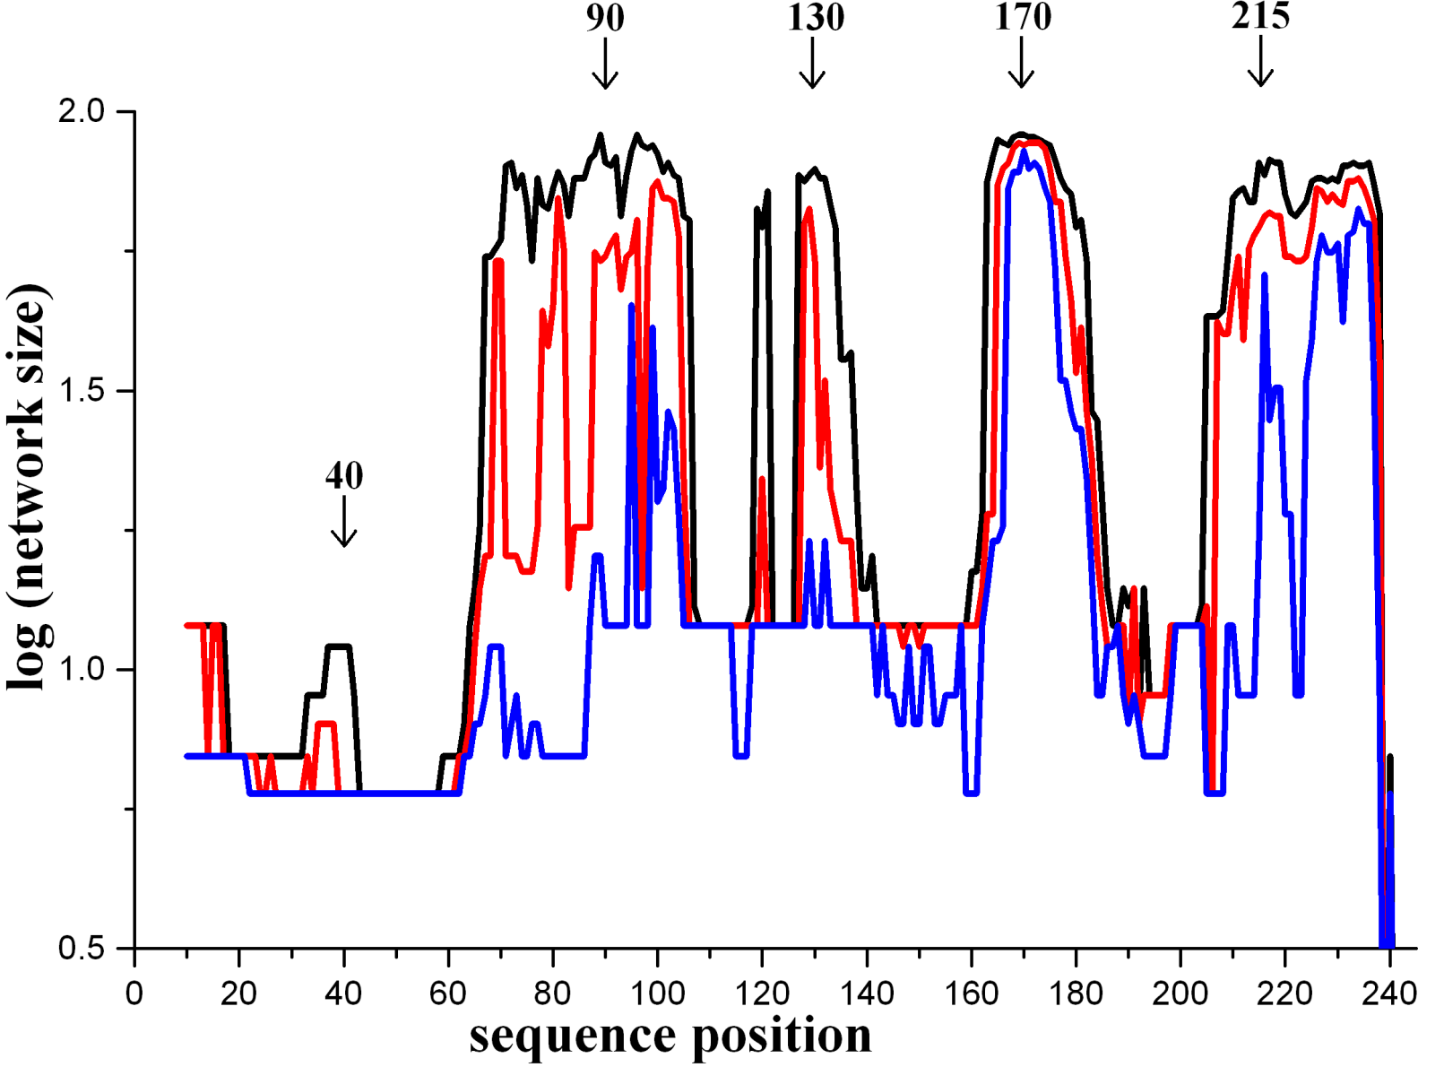
Modules of TIM-barrell protein

Slide 29
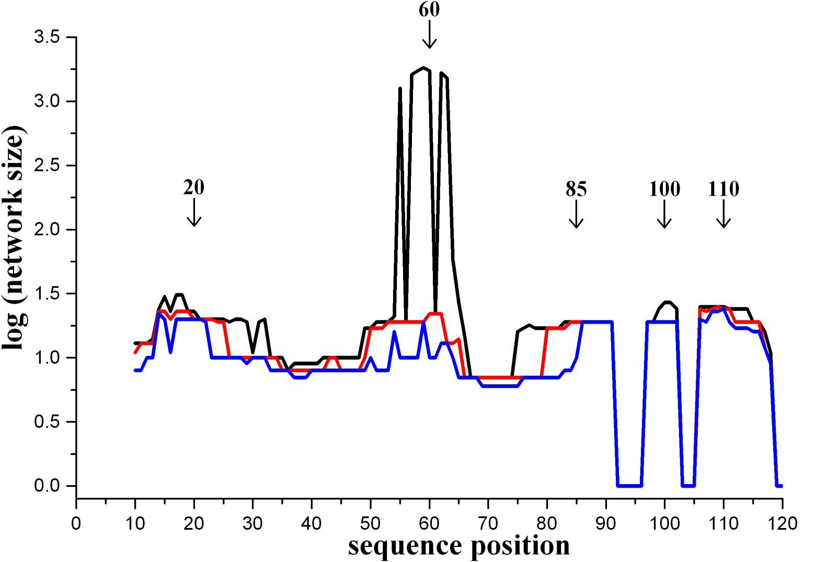
Modules of chemotaxis protein cheY

Slide 30
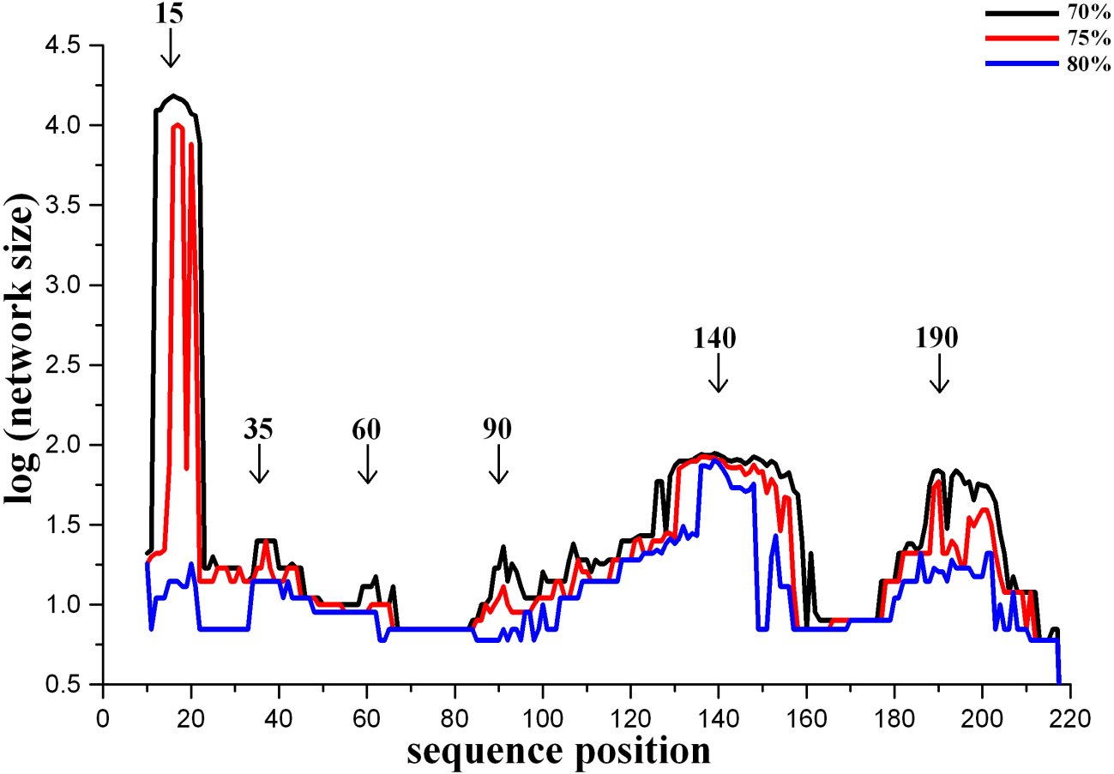
Modules of cytidylate kinase

Slide 31
Specific functions of individual module types
are largely not known yet.
Since, however, they represent wide-spread, conserved
and, thus, functional motifs,
their individual roles will have to be eventually elucidated.
One peculiar class of modules are so-called „silent modules“,
which have only few relatives in the sequence space, if at all.

Slide 32
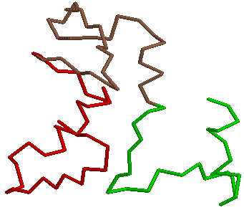
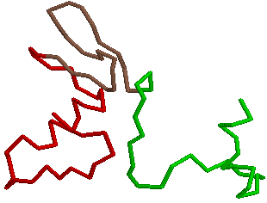
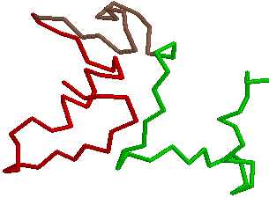
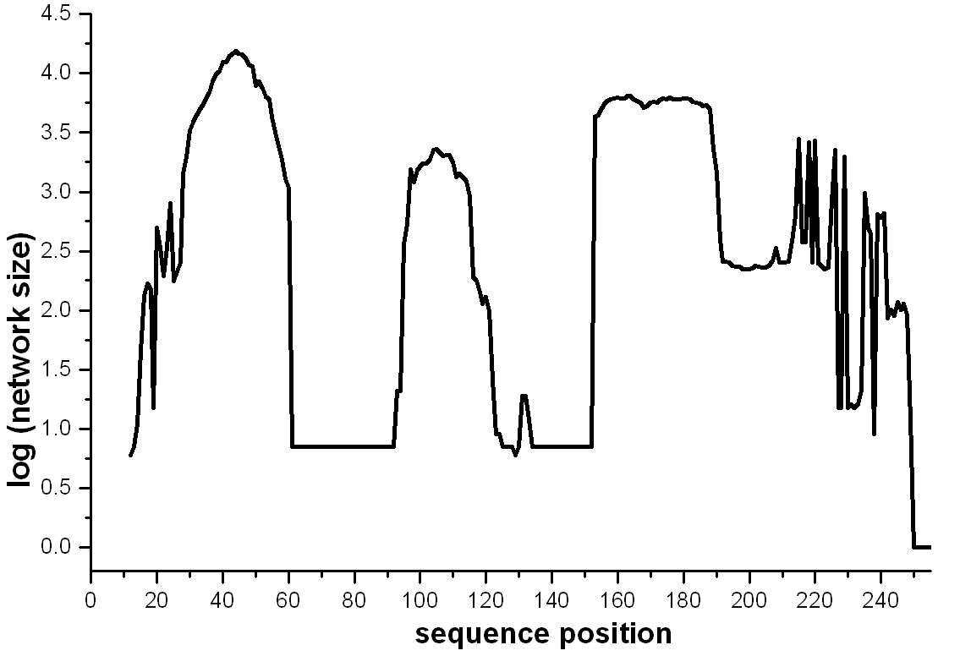
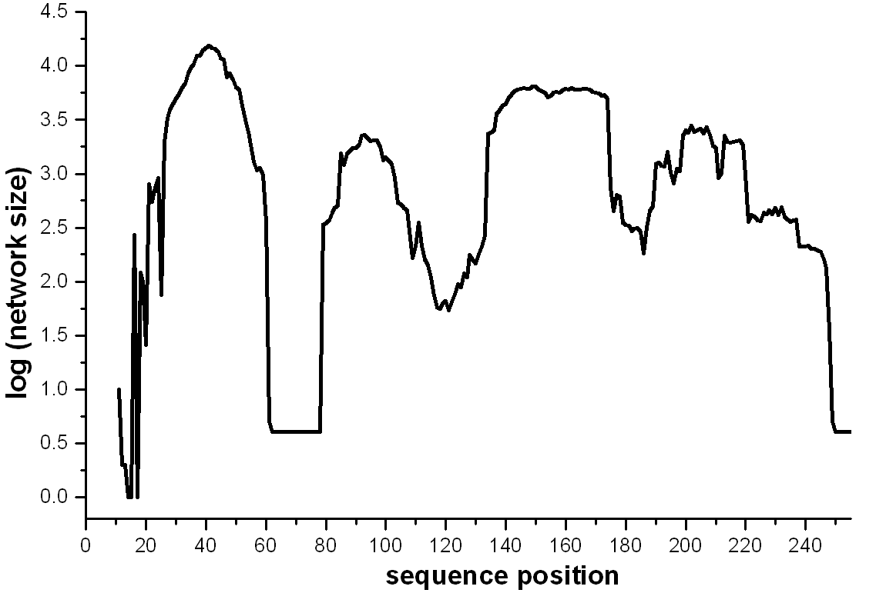
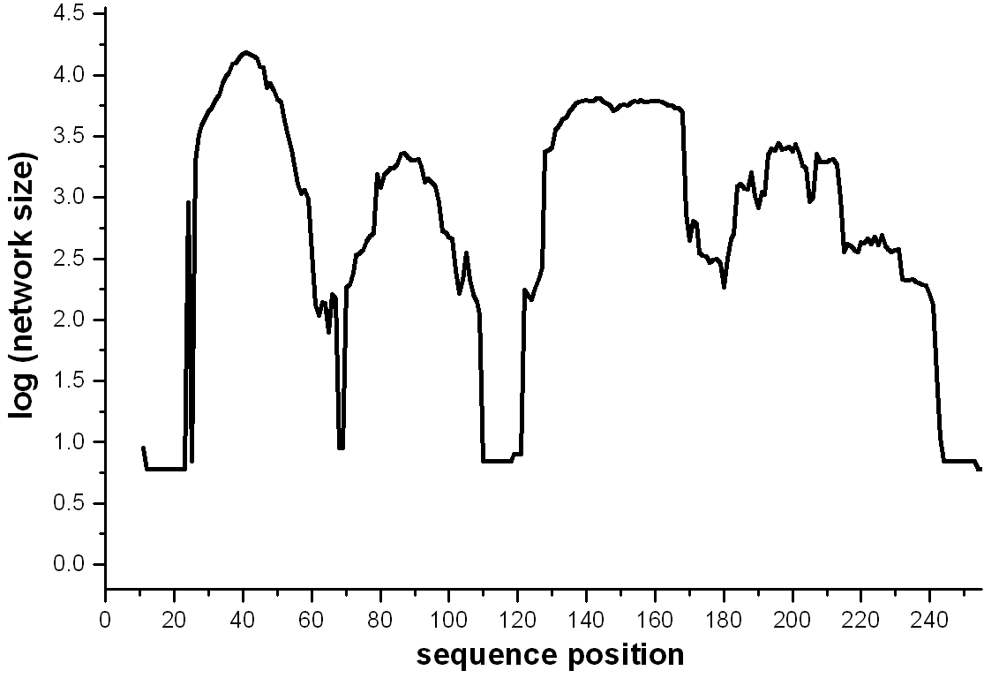
silent module 1
silent module 2
silent module 3
D
D
D
A
A
A
A
A
A
D
D
D
1
3
2
A silent modules 1-3 D
IVLLVGPSGSGKTTLLRALAGLLGPDGG RRGIGMVFQEYALFPHLTVLENVALGL
| ||||| | || | | | | |||| | | ||||||
VISIIGSSGSGKSTFLRCINFLEKPSEGSIVVNGQTINLVRDKDGQLKVADKNQLRLLRTRLTMVFQHFNLWSHMTVLENVMEAP 1
| ||||| | || | || || | || | | | |||| | |||| |
FMILLGPSGCGKTTTLRMIAGLEEPSRG---QIYIGDRLVADPEKGIFVPPK------DRDIAMVFQSYALYPHMTVYDNIAFPL 2
| ||||||| | |||||||| | | || | |||||||||||| | | | |
FVVFVGPSGCGKSTLLRMIAGLETITSG---------DLFIGEKRMNDTPPA------ERGVGMVFQSYALYPHLSVAENMSFGL 3
The silent modules appear to maintain
3D structural relationships between functionall modules

Slide 33
Application 3:
Molecular evolution

Slide 34
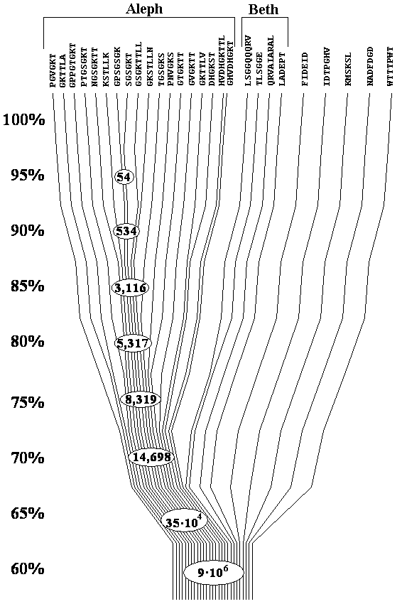
Sequence space based
evolutionary tree of omnipresent elements

Slide 35
Descriptive definition of protein modules:
Their sequences are represented by networks
in the protein sequence space -
separate network (or group of related networks) for each module.
Each module has its own unique structure.
Typically, these are closed loops of the contour length 25-30 residues.
Apart from general activity ascribed to the protein that harbors given module,
each module type has its own specific function.
Individual modules even of the same type are sequence-wise often different.
Their evolution from ancestral prototypes
may be traced along walks and networks in the sequence space.

Slide 36
Additional application:
Sequence space mapping
reveals
landmarks of protein structure

Slide 37
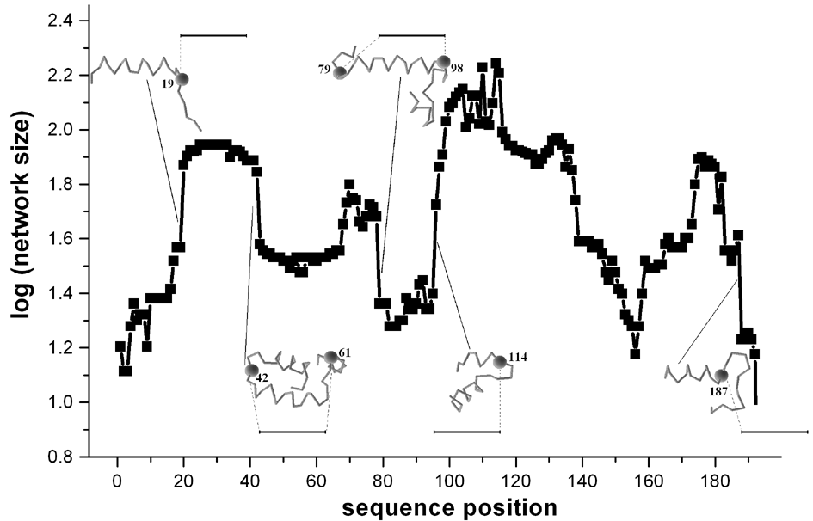

Slide 38
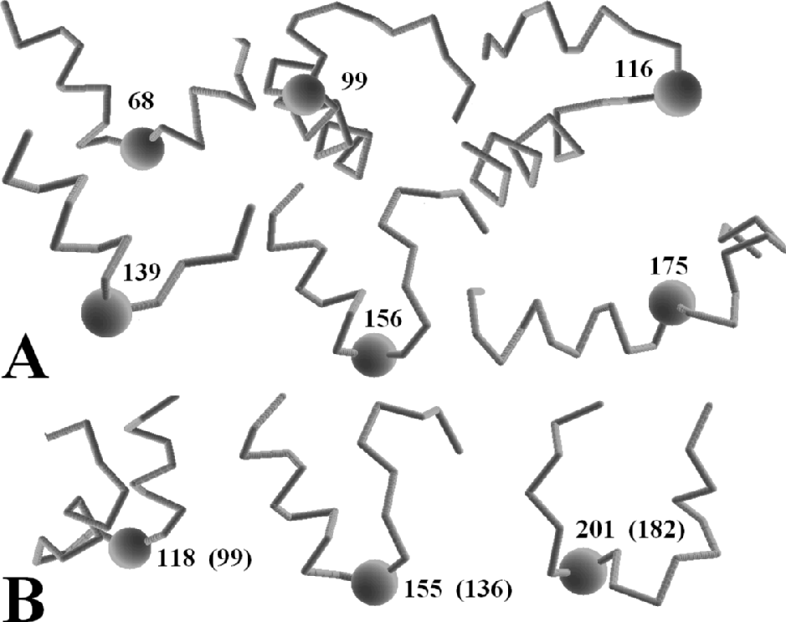

Slide 39
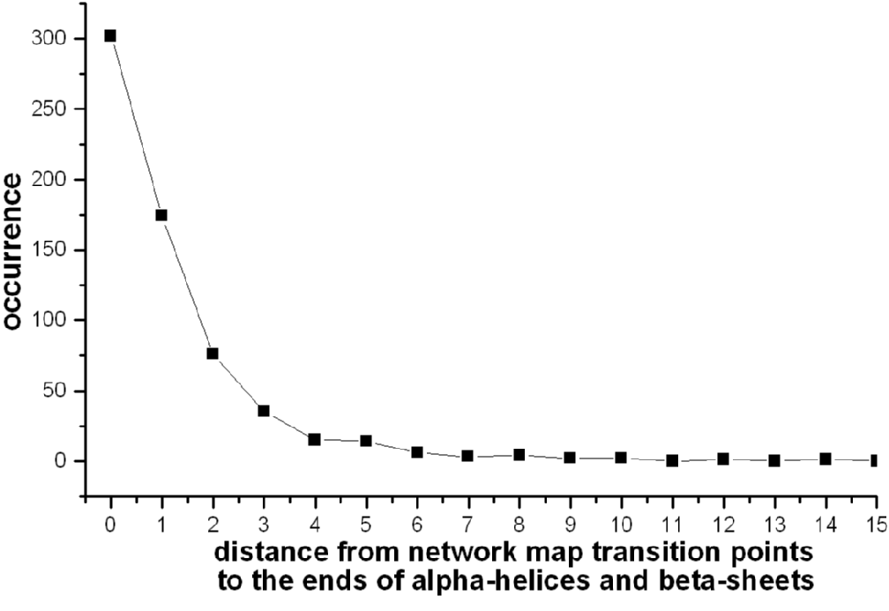
Distribution of distances between the ends of 20 aa fragments corresponding to sharp transitions in the network maps and the boundaries of the alpha-helices and beta-sheets

Slide 40
Application 4:
Sequence alignment

Slide 41
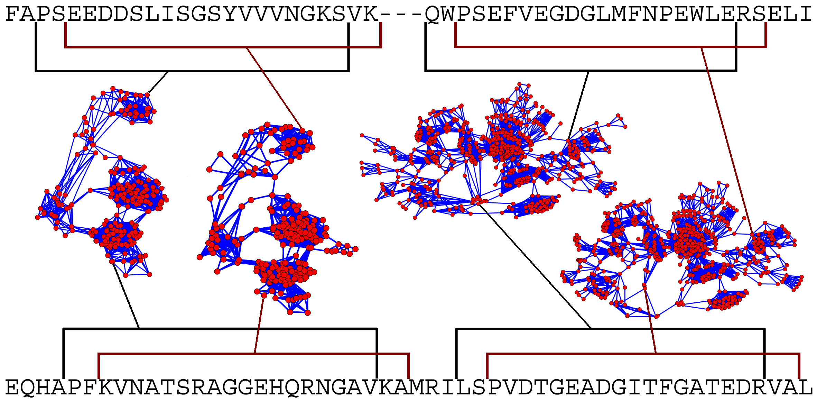
Schematic illustration of the alignment by networks and detection of indels. The 20 aa fragments (selected by brackets), belonging to the same network, should correspond to one another in the alignment. The mapping of indels is a natural outcome of the procedure.

Slide 42
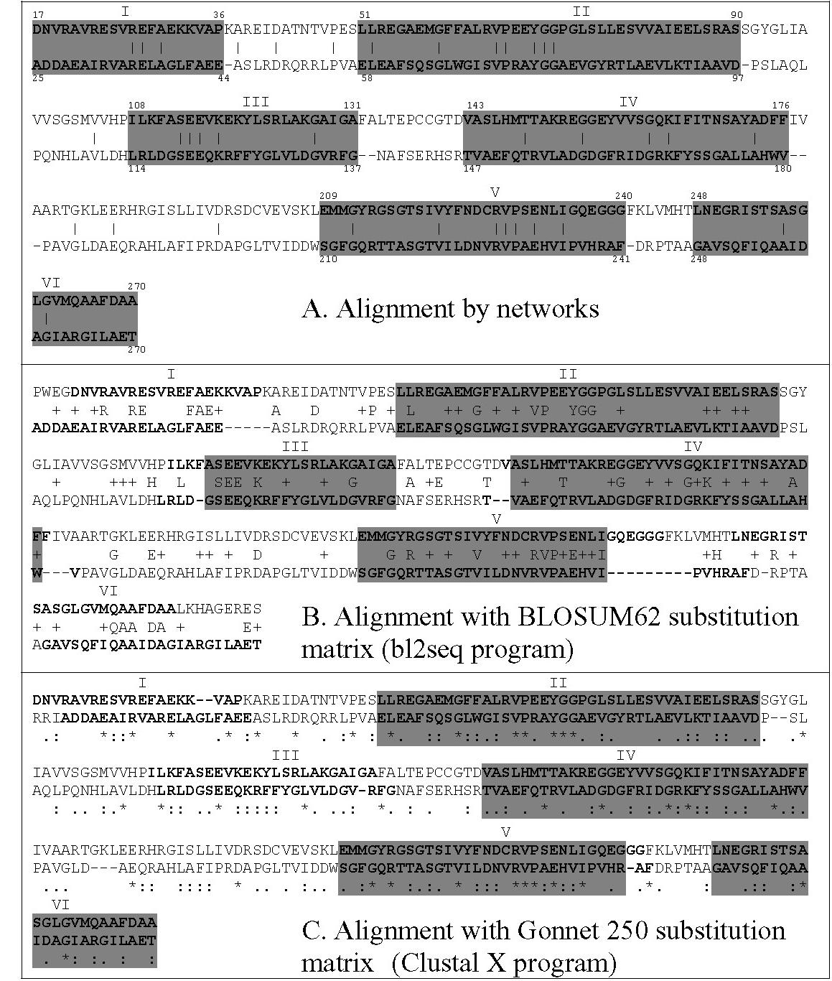
Comparison of the network alignment (A) with alignments made with BLOSUM62 (B) and Gonnet 250 (C) substitution matrices.
The sequence parts in A, B, and C, which are connected via the networks, are shown in bold.
Matching segments, by the three methods of alignment, are enclosed in gray boxes.

Slide 43
Introduction of fake edges
Consider a simple PCN:
A1 – X1 – O – X2 – A2
where A1 and A2 are the nodes with identical 3D-structure; O – the node that we want to annotate; X1 and X2 some not-annotated nodes.
Let's for simplicity
R(A1-X1-O) = R(A2-X2-O)

Slide 44
Introduction of fake edges
Now, if we introduce a new edge A1-A2 with
R(A1-A2) = 0
A1 – X1 – O – X2 – A2
the resistance between A1 and O, according to Ohm's low for parallel connection:
1/R(A1-O) = 1/ R(A1-X1-O) +1/( R(A1-A2)+R(A1-X1-O))
Now:
R(A1-O) = R(A1-X1-O)/2

Slide 45
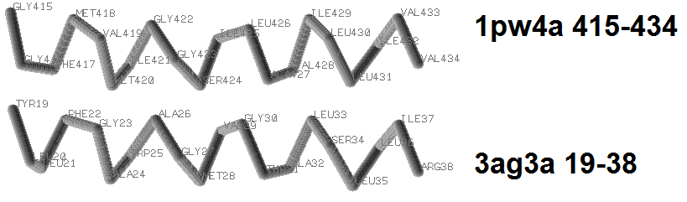
Introduction of fake edges
A real example: RMSD = 1.01A
1pw4 (A:) 415-434
gfmvmiggsilavillivvm
..............|.....
yllfgawagmvgtalsllir
3ag3 (A:) 19-39

Slide 46
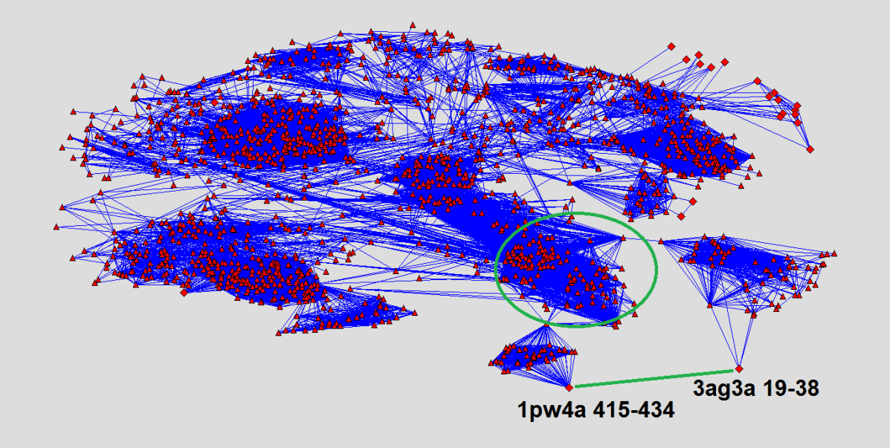
Introduction of fake edges
A real example: RMSD = 1.01A

Slide 47
The recent study
Enhancing PCN analysis capability by network reduction and an advanced storage/retrieval technology
Together with our excellent students:
Shimon Arzuan
Ron Rosenfeld

Slide 48
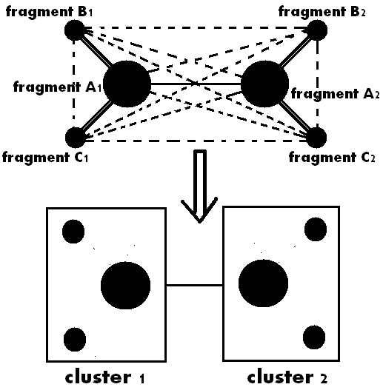
The recent study
The idea:
to use clustering for the network lossy compression

Slide 49
The recent study
Pre-Processing block diagram

Slide 50
The recent study - Results
Disk size reduction Vs. Threshold
(Original PCN disk size 11026081[Kb])
Disk Reduction [%] | cluster file disk size [Gb] | PCN disk size [Gb] | Threshold [%]
74.3552673 | 0.655984879 | 2.040633202 | 70
73.0370292 | 0.612704277 | 2.222530365 | 75
70.49833028 | 0.565315247 | 2.536870956 | 80
66.02338582 | 0.513350487 | 3.059389114 | 85
60.52027915 | 0.455978394 | 3.695428848 | 90
53.55395992 | 0.390209198 | 4.49372673 | 95
40.08845935 | 0.303277969 | 5.996594429 | 100

Slide 51
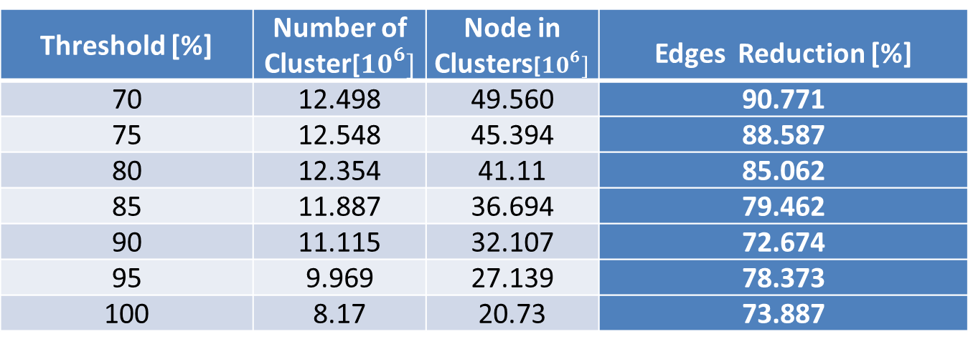
The recent study - Results
nodes and cluster number in relation to threshold
Edges Reduction [%] | Node in Clusters[$10^{6}]$ | Number of Cluster[$10^{6}]$ | Threshold [%]
90.771 | 49.560 | 12.498 | 70
88.587 | 45.394 | 12.548 | 75
85.062 | 41.11 | 12.354 | 80
79.462 | 36.694 | 11.887 | 85
72.674 | 32.107 | 11.115 | 90
78.373 | 27.139 | 9.969 | 95
73.887 | 20.73 | 8.17 | 100

Slide 52
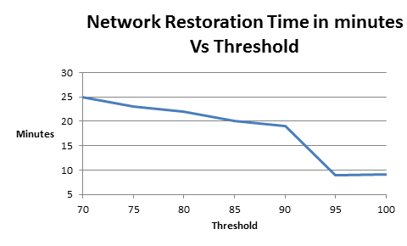
The recent study - Results

Slide 53
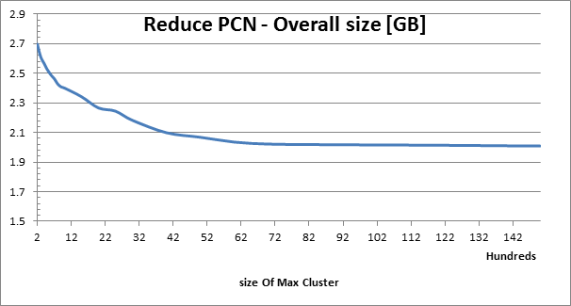
The recent study - Results
Overall disk size consumption Vs size of maximum clusters

